Slide 1
Designing Testable Applications
Part II: DB Integration & Legacy Code

Slide 2
Agenda
Objectives
Database Integration: Tips & Samples
Legacy Code Refactoring: Tips & Samples
Coding time!
Feedback
Summary

Slide 3

Objectives
Divulge the use of best practices such as unit & integration testing and continuous integration
Provide developers with the necessary tools to design and develop applications using these practices (How?)
Advantages of using these practices (Why?)
I have inherited non-testable legacy code. Where do I start?

Slide 4
Database Integration: Tips & Samples

Slide 5
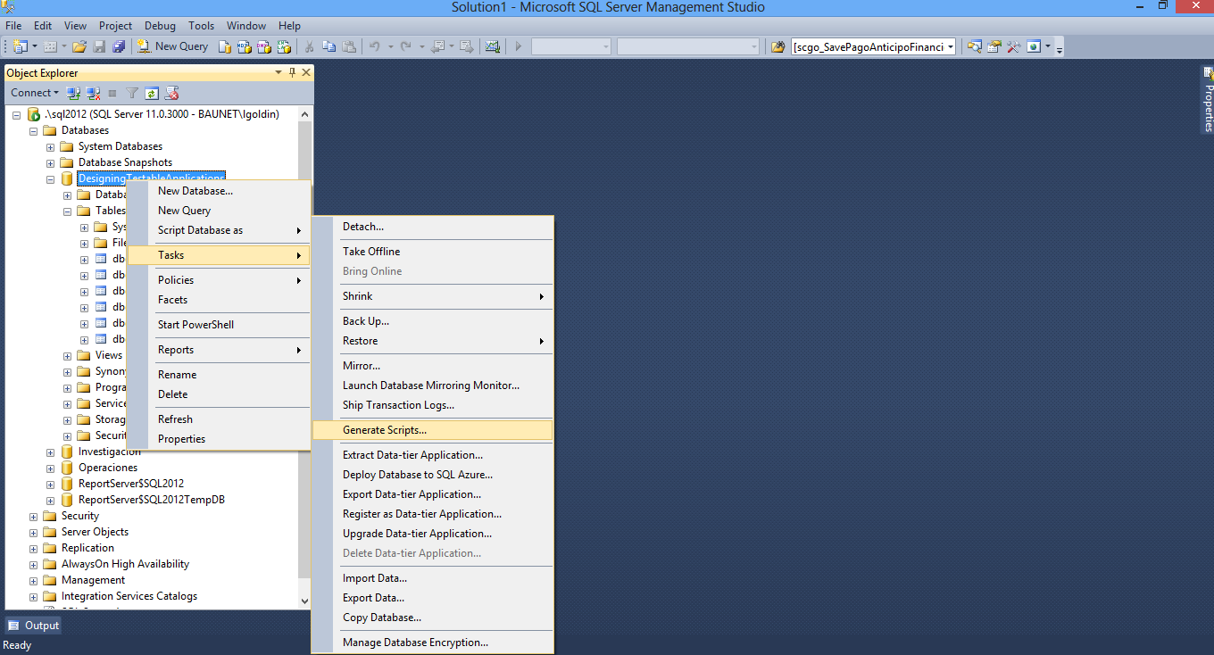
Tip 1: Generate creation scripts for DB, Tables, Views, SPs, Functions

Slide 6
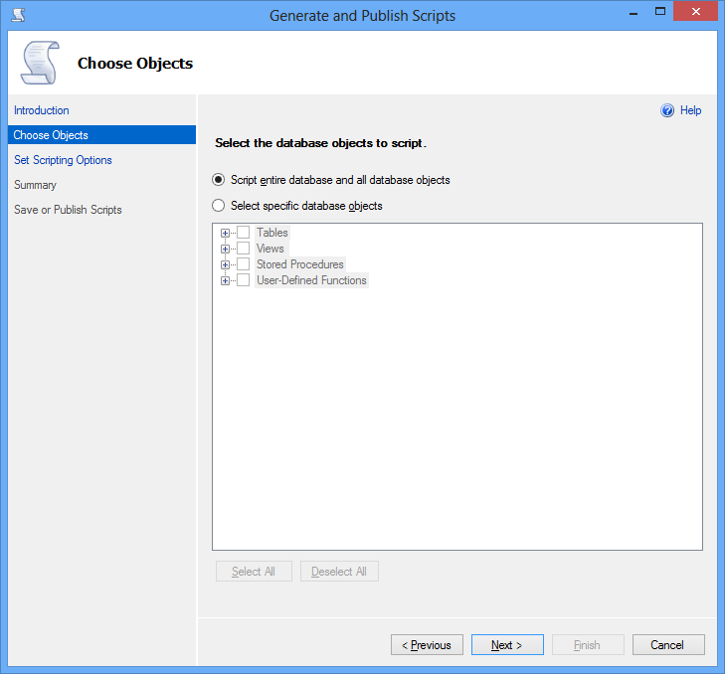
Tip 1: Generate creation scripts for DB, Tables, Views, SPs, Functions

Slide 7
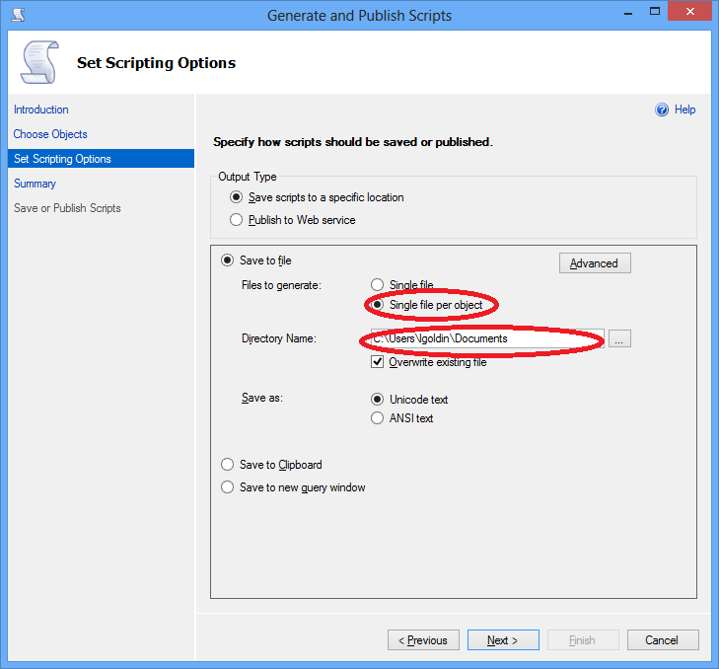
Tip 1: Generate creation scripts for DB, Tables, Views, SPs, Functions

Slide 8
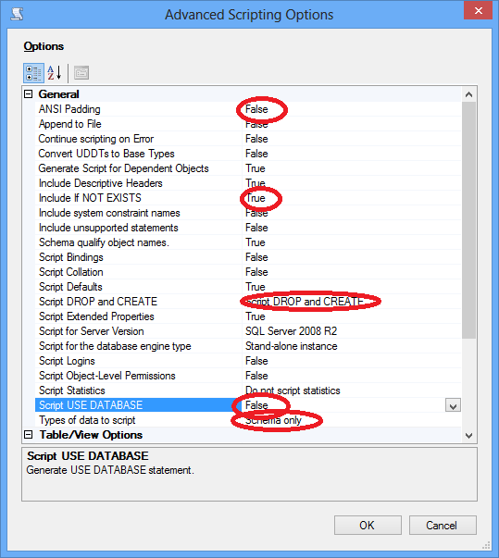
Tip 1: Generate creation scripts for DB, Tables, Views, SPs, Functions

Slide 9
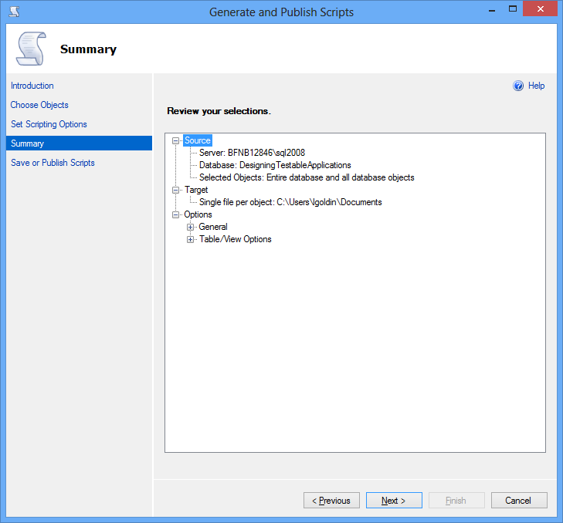
Tip 1: Generate creation scripts for DB, Tables, Views, SPs, Functions

Slide 10
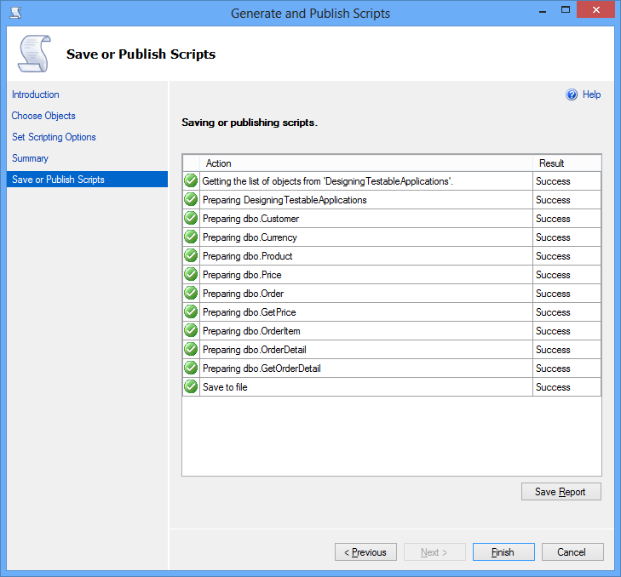
Tip 1: Generate creation scripts for DB, Tables, Views, SPs, Functions

Slide 11
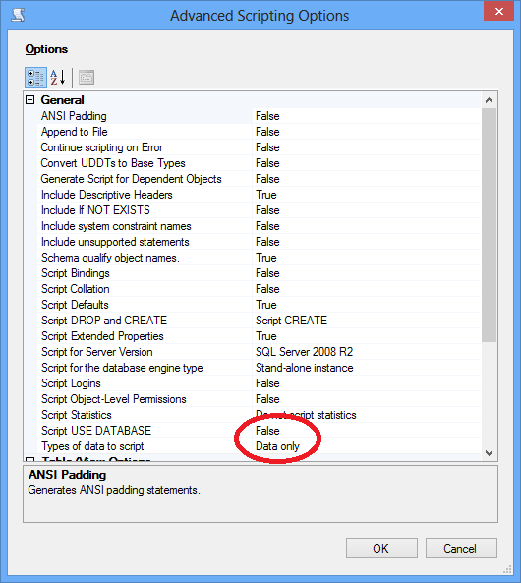
Tip 2: Generate “master” data insertion scripts

Slide 12
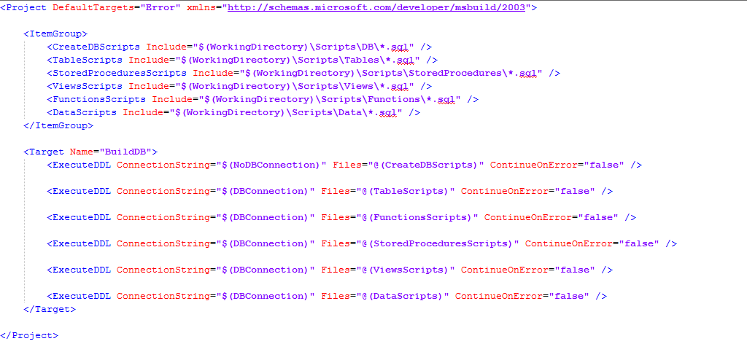
Tip 3: Execute scripts automatically

Slide 13
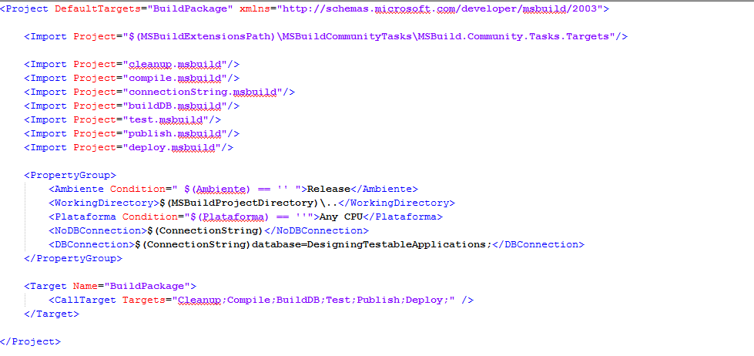
Tip 3: Execute scripts automatically

Slide 14
Tip 4: Setup test data (initialization & cleanup)
Test Initialization
Initialize the database context and/or transactions
Add test data that you may need in tests
Test Cleanup
Return the database to its original state to allow tests to be run multiple times with the expected result*
Delete test data and/or rollback transactions
Make sure database connections are disposed
(*) Be careful with identity IDs!

Slide 15
Tip 5: Generate Integration tests
Integration tests
Complementary to unit testing
Uses dependencies such as to a database
May be used to test stored procedures and calls to external applications
Are less performant than unit tests and sometimes executed less often
Focus on methods with dependencies, not end-to-end application testing
How to write integration tests:
Setup preconditions
Execute the code to be tested
Assert on the expected results

Slide 16
Tip 5: Generate Integration tests
A good integration test:
Uses dependencies in a controlled way
Documents your design
Can be run in any order if part of many other tests
Consistently returns the same result
Tests a single logical concept in the system
Is named clearly and consistently
Is readable
Is maintainable

Slide 17
Tip 6: Add Integration Tests to MSBuild
Refer to Tip 8: Create MSBuild configuration
Add Integration tests to your MSBuild, just as you did with your Unit tests!
Check-in changes so the Integration tests are run on your CI server
You now have a fully testable application, congratulations!
Now, make sure you keep your test coverage up in the sky!

Slide 18
Legacy Code Refactoring: Tips & Samples

Slide 19
Working with Legacy Code
Making changes to legacy code raises two alternatives:
Edit and pray
Cover and modify
Refactoring dilemma
When we change code, we should have tests in place
To put tests in place, we often have to change code
Legacy code often:
Has dependencies coupled to concrete implementations
Uses singletons and static variables
Has significant work happening in the constructor
Has objects that cannot be easily created
Usually has code with multiple responsibilities (not-SOLID)

Slide 20
Tip 1: Decouple method code
Extract concrete implementations to interfaces
Tip 1: Program to an interface, not an implementation
Tip 2: Use constructor dependency injection
Allows you to mock dependencies for unit testing
Careful with hidden dependencies
Eg. Constructor creates an instance of another class
When adding constructors for dependency injection, keep a parameterless constructor to avoid changing existing code
Use wrappers to decouple code from third-party libraries we cannot instanciate
Tip 7: Use wrappers to encapsulate static dependencies
Keep best practices for writing testable code in mind
Tip 3: Favour composition over inheritance
Tip 6: Writing Testable Code

Slide 21
Tip 2: Test method
Decoupling made your application testable, test it!
Tip 4: Generate Unit tests
Tip 5: Mock dependencies
Run tests on your CI server
Tip 8: Create MSBuild configuration
Tip 9: Upload solution to CI server
Ensure tests properly test the expected application behaviour

Slide 22
Tip 3: Refactoring
Code refactoring is the process of restructuring existing computer code without changing its external behavior
Advantages
Improved code readability
Reduced complexity
Improved source code maintainability
Improved code extensibility
Identify hidden, dormant or undiscovered bugs
Helps identify improvement opportunities
Allows you to design testable applications
In your application
Make sure all tests pass before changing application code
After changing application code, all tests should still pass

Slide 23
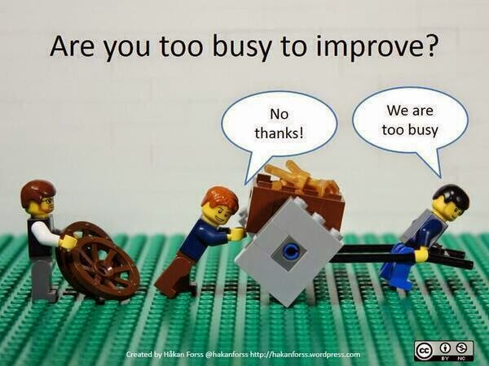
Tip 3: Refactoring
Convince yourselves (and your pals!) refactoring is an investment, not a time loss

Slide 24
The Legacy Code Change Algorithm
Identify change points
Find the place where you want to make the next change in order to add features or eliminate bugs
Find test points
Break dependencies
Where it is difficult or impossible to write tests to get coverage of the current behavior at the test points
Pre-refactoring is tricky as you don’t yet have tests to protect you as you work
Write tests
Make changes and refactor
Refactor the change point in the normal testable manner
Enjoy the test coverage you’ve built

Slide 25
Coding time!

Slide 26
Coding time!
Enunciado (oops, we got the language wrong!)
Como la empresa está festejando su 10° aniversario, los directivos decidieron ofrecer una promoción especial.
Los clientes que compren frecuentemente serán beneficiados a partir de un esquema de puntos obtenidos mediante cada compra, con los que podrán acceder a beneficios desopilantes.
Los puntos se otorgarán según los siguientes rangos:
Compra entre $1 y $4999: Puntos otorgados = Monto Compra * 1
Compra entre $5000 y $9999: Puntos otorgados = Monto Compra * 2
Compra entre $10000 y $19999: Puntos otorgados = Monto Compra * 3
Compra mayor a $20000: Puntos otorgados = Monto Compra * 4
Objetivo
Implementar los nuevos requerimientos de negocio, asegurando mediante tests unitarios, que se cumplan adecuadamente y que no se vea afectada la funcionalidad actual de la aplicación.
Los tests de integración que ya tiene la aplicación deben seguir ejecutando exitosamente.
Se permite (y recomienda!) hacer todos los cambios que sean necesarios para que la aplicación sea testeable.

Slide 27

Questions

Slide 28
Feedback

Slide 29
Feedback
What do you think about using these practices in your projects?
What advantages would you have by incorporating these practices in your current project?
What’s your take on the concepts of today’s talk?

Slide 30
Summary

Slide 31
Summary
These practices:
Make your code more maintainable
Minimize the number of errors in the final product
Allow early detection of errors in the development environment
Reduce development and maintenance time over the project’s lifecycle
Improve the quality of the final product

Slide 32
Summary
These practices will also:
Improve the development team’s internal organization
Maintain a current build always available for testing, demos or deployment
Allow you to generate metrics of code quality, test coverage, etc.

Slide 33
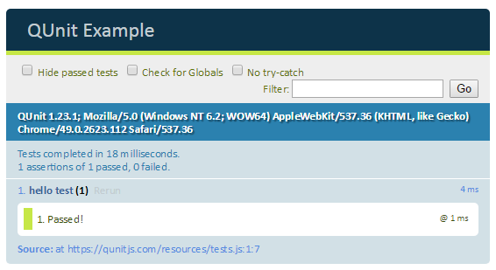
Part III: Scenes of the next episode…
Unit Testing JavaScript views

Slide 34






Thanks! Leandro Goldin lgoldin@baufest.com Christian Smirnoff csmirnoff@baufest.com
USA
Tel +1 (617) 275-2420 1 Broadway 14th floor Cambridge, MA 02142
USA
Mexico
Tel.: +52 (55) 5531-8878 Fax: +52 (55) 5531-8878 Avda. Ejército Nacional 678, Col. Polanco Reforma,
Distrito Federal C.P. 11550
México D.F.
Argentina
Buenos Aires
Tel.: +54 (11) 4118-8080
Fax: +54 (11) 4118-8080
Roosevelt 1655
C1428BNC, Buenos Aires
Argentina
Santa Fe
Tel.: +54 (342) 412-0368
San Jerónimo 1838
S3000FPP, Santa Fe
Argentina
Spain
Tel.: +34 91 745-2763
Fax: +34 91 561-5626
c/ Francisco Giralte, 2
28002, Madrid
Spain

